Slide 1
CertifAI: Automated Certificate Data Extraction
Group Members:
Govindula Srinith(211010226)
Rapolu Shiva Teja(211020435)
Kadali Umesh Chandra(211020423)
Supervisor name:
Dr. Mallikharjuna Rao
Date:05-03-2023
International Institute of Information Technology, Naya Raipur

Slide 2

Content
Introduction
Motivation
Literature Review
Research Gap
Problem definition
Objectives
Proposed Framework/Methodology
Plan of action for the project
International Institute of Information Technology, Naya Raipur

Slide 3

Introduction
Management and extraction of data from various documents is becoming increasingly important.
Extraction of essential information from documents can greatly enhance efficiency and accuracy.
As organizations grow and handle increasing amounts of data, scalability becomes a pressing concern.
International Institute of Information Technology, Naya Raipur

Slide 4
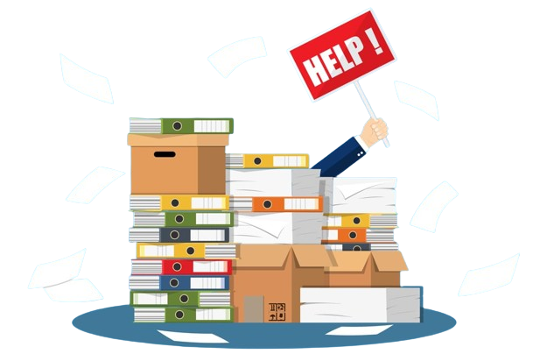
Motivation
Labor intensive
Efficiency
Standardization
Error prone
Scalability
International Institute of Information Technology, Naya Raipur

Slide 5
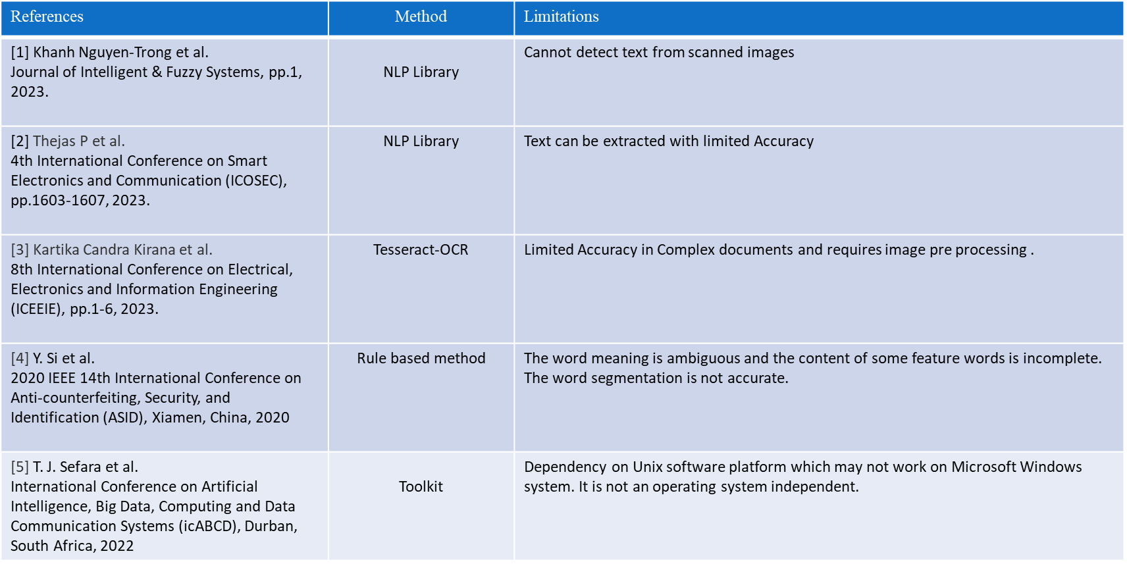
Literature Review
International Institute of Information Technology, Naya Raipur

Slide 6

Research Gap
Semantic Understanding
Adaptability to Different Certificate Types
Handling Handwritten Text
Independent of Operating System
International Institute of Information Technology, Naya Raipur

Slide 7
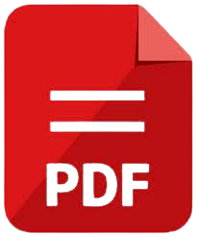
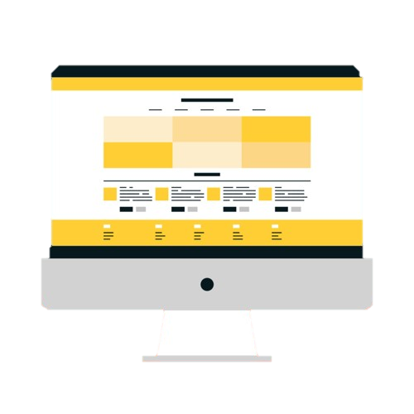
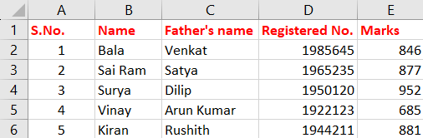
Problem Definition/Problem statement
Extract the information from the pdf documents from certificates and present them in a structured way
International Institute of Information Technology, Naya Raipur

Slide 8

Objective (s) of the Project
Streamlining document processing workflows:
  Develop a Python script capable of accurately extracting key details from certificates.
  Handle a variety of certificate formats and layouts, using OCR techniques to extract text.
  Storing them in a structured format, such as a CSV file.
International Institute of Information Technology, Naya Raipur

Slide 9

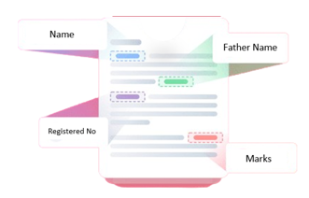
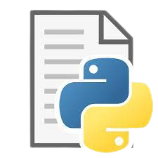


Proposed Framework/Methodology

Slide 10
Plan of action for the remaining project work
Create a user interface
2. Trying different types of models for data extraction
3. Integrating with suitable API
4. Setting benchmarks for the pdf extraction
International Institute of Information Technology, Naya Raipur

Slide 11
References
[1] Khanh Nguyen-Trong, Thinh Trinh, "Information extraction from Visually Rich Documents using graph convolutional network", Journal of Intelligent & Fuzzy Systems, pp.1, 2023.
[2] Thejas P, S Anupama Kumar, Y S Kiran Kumar, "Development of an NLP-Based Automatic Data Retrieval Model", 2023 4th International Conference on Smart Electronics and Communication (ICOSEC), pp.1603-1607, 2023.
[3] Kartika Candra Kirana, Gres Dyah Kusuma Ningrum, Dila Umnia Soraya, Febrianto Alqodri, Ahmad Akbar Mubarak, Slamet Wibawanto, "Synchronization of the Internship Registration System using a Study Plan and Acceptance Letter Based on Tesseract-OCR and Template Matching", 2023 8th International Conference on Electrical, Electronics and Information Engineering (ICEEIE), pp.1-6, 2023.
[4] Y. Si, W. Zhou and J. Gai, "Research and Implementation of Data Extraction Method Based on NLP," 2020 IEEE 14th International Conference on Anti-counterfeiting, Security, and Identification (ASID), Xiamen, China, 2020, pp. 11-15, doi: 10.1109/ASID50160.2020.9271745.
[5] T. J. Sefara, M. Mbooi, K. Mashile, T. Rambuda and M. Rangata, "A Toolkit for Text Extraction and Analysis for Natural Language Processing Tasks," 2022 International Conference on Artificial Intelligence, Big Data, Computing and Data Communication Systems (icABCD), Durban, South Africa, 2022, pp. 1-6, doi: 10.1109/icABCD54961.2022.9856269.
International Institute of Information Technology, Naya Raipur

Slide 12

Thank You
..
Dr. Shyama Prasad Mukherjee International Institute of Information Technology, Naya Raipur
International Institute of Information Technology, Naya Raipur

